Slide 1
Extreme Weather Prediction using Deep Learning
Yash Thesia, Vidhey Oza
Under Dr. Priyank Thakkar
Associate Professor,
CSE Department,
Institute of Technology,
Nirma University.
Under Dr. Nitant Dube
Scientist/Engineer
Space Applications Centre
ISRO
Yash Thesia : 15BCE126 , Vidhey Oza : 15BCE130

Slide 2
Internship Details
Organisation : Indian Space Research Organisation (ISRO)
Program : SMART (Satellite Meteorology and OceAnography Research and Training)
Location : Bopal, Ahmedabad, Gujarat
Internship Definition : Extreme weather prediction using deep learning techniques on Indian subcontinent feature images.

Slide 3
Introduction
Sub Definition : The goal of precipitation nowcasting is to predict the future rainfall intensity in a local region over a relatively short period of time.
Dataset : INSAT3D
Time Interval : 30 mins, 1hr, 2hr … 6hrs.

Slide 4
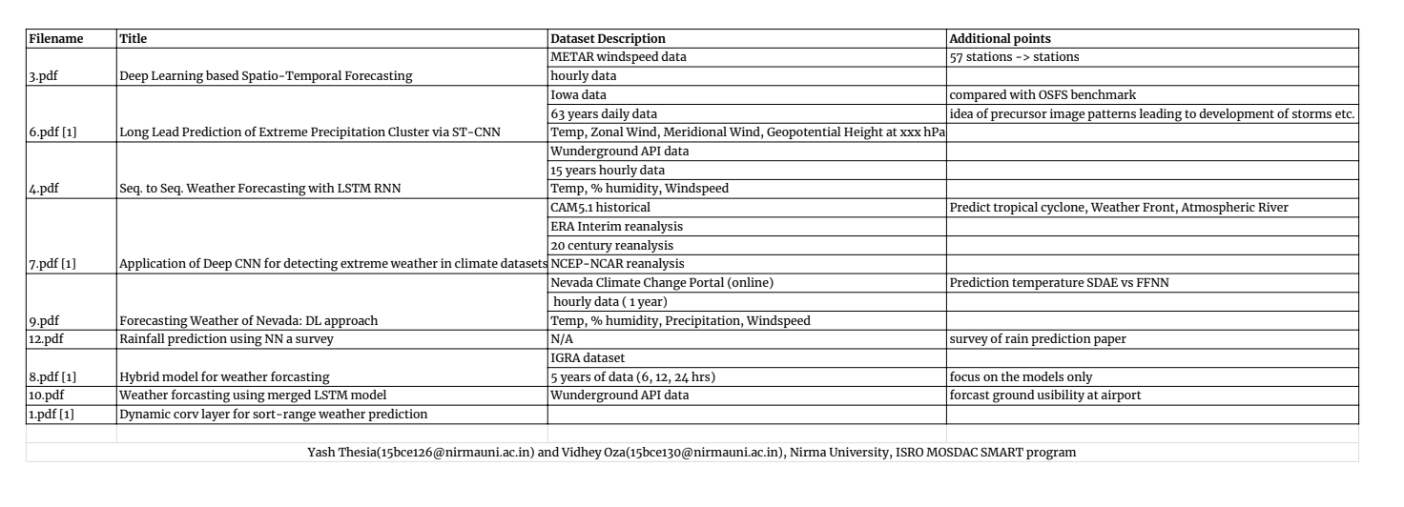
Datasets used in previous research

Slide 5
Dataset Details
INSAT 3D module
6 channel data
3 levels of processing
L1: Standard grey counts of different spectra (e.g., visible, shortwave IR, mid-wave IR)
L2: Geo-physical products (e.g., winds, rainfall, fog)
L3: Derived products (e.g., long-wave radiation, humidity)
Preliminary work on L1C data
Asia Sector TIR1 Brightness Temperature
100 images of temperature level Indian subcontinent
Image interval: 30 mins/image

Slide 6
Dataset Preprocessing
Satellite calibration errors
Missing images
Missing values within image
100 images of temperature level Indian subcontinent
Image interval: 30 mins/image

Slide 7
Preliminaries
Forecasting of next frame; using this learning for extreme weather prediction
Convolutional networks with consideration of sequence modelling
Conv3D (3D filters on multi-channel images)
ConvLSTM (proposed for the nowcasting problem)

Slide 8
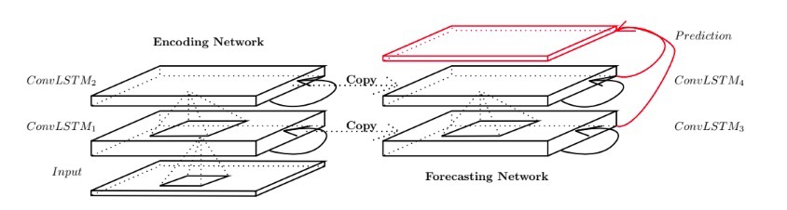
ConvLSTM architecture
Fig. 4: Groundbreaking architecture of ConvLSTM node, as presented in [1].

Slide 9
Future Work and Subgoals
Once preliminary efficacy of models and approaches established, move on to L2 or L3 products for more relevant data for extreme
Different approaches for different extreme weather classes; to be discussed with domain experts on-site
Flood-like conditions due to extreme rainfall
Tropical Cyclones
Atmospheric Rivers
…

Slide 10
References
Xingjian, S. H. I., et al. "Convolutional LSTM network: A machine learning approach for precipitation nowcasting." Advances in neural information processing systems. 2015.
Ghaderi, Amir, Borhan M. Sanandaji, and Faezeh Ghaderi. "Deep forecast: deep learning-based spatio-temporal forecasting." arXiv preprint arXiv:1707.08110 (2017).
Zhuang, W. Y., and Wei Ding. "Long-lead prediction of extreme precipitation cluster via a spatiotemporal convolutional neural network." Proceedings of the 6th International Workshop on Climate Informatics: CI. 2016.
Liu, Yunjie, et al. "Application of deep convolutional neural networks for detecting extreme weather in climate datasets." arXiv preprint arXiv:1605.01156(2016).
Grover, Aditya, Ashish Kapoor, and Eric Horvitz. "A deep hybrid model for weather forecasting." Proceedings of the 21th ACM SIGKDD International Conference on Knowledge Discovery and Data Mining. ACM, 2015.
B. Klein, L. Wolf and Y. Afek, "A Dynamic Convolutional Layer for short rangeweather prediction," 2015 IEEE Conference on Computer Vision and Pattern Recognition (CVPR), Boston, MA, 2015, pp. 4840-4848.
Zaytar, Mohamed Akram, and Chaker El Amrani. "Sequence to sequence weather forecasting with long short term memory recurrent neural networks." Int J Comput Appl 143.11 (2016).

Slide 11
References
Salman, Afan Galih, Bayu Kanigoro, and Yaya Heryadi. "Weather forecasting using deep learning techniques." Advanced Computer Science and Information Systems (ICACSIS), 2015 International Conference on. IEEE, 2015.
Grover, Aditya, Ashish Kapoor, and Eric Horvitz. "A deep hybrid model for weather forecasting." Proceedings of the 21th ACM SIGKDD International Conference on Knowledge Discovery and Data Mining. ACM, 2015.
Hossain, Moinul, et al. "Forecasting the weather of Nevada: A deep learning approach." Neural Networks (IJCNN), 2015 International Joint Conference on. IEEE, 2015.
Salman, Afan Galih, et al. "Weather Forecasting Using Merged Long Short-term Memory Model." Bulletin of Electrical Engineering and Informatics 7.3 (2018): 377-385.
Nhita, Fhira, Deni Saepudin, and Untari Novia Wisesty. "Comparative Study of Moving Average on Rainfall Time Series Data for Rainfall Forecasting Based on Evolving Neural Network Classifier." Computational and Business Intelligence (ISCBI), 2015 3rd International Symposium on. IEEE, 2015.
P. Darji, Mohini & Dabhi, Vipul & Prajapati, Harshadkumar. (2015). Rainfall forecasting using neural network: A survey. 10.1109/ICACEA.2015.7164782.
Zhang, Xike, et al. "A Novel Hybrid Data-Driven Model for Daily Land Surface Temperature Forecasting Using Long Short-Term Memory Neural Network Based on Ensemble Empirical Mode Decomposition." International journal of environmental research and public health 15.5 (2018): 1032.
Karim, Fazle, et al. "LSTM fully convolutional networks for time series classification." IEEE Access 6 (2018): 1662-1669.
Kim, Seongchan, et al. "DeepRain: ConvLSTM Network for Precipitation Prediction using Multichannel Radar Data." arXiv preprint arXiv:1711.02316 (2017).

